Slide 1
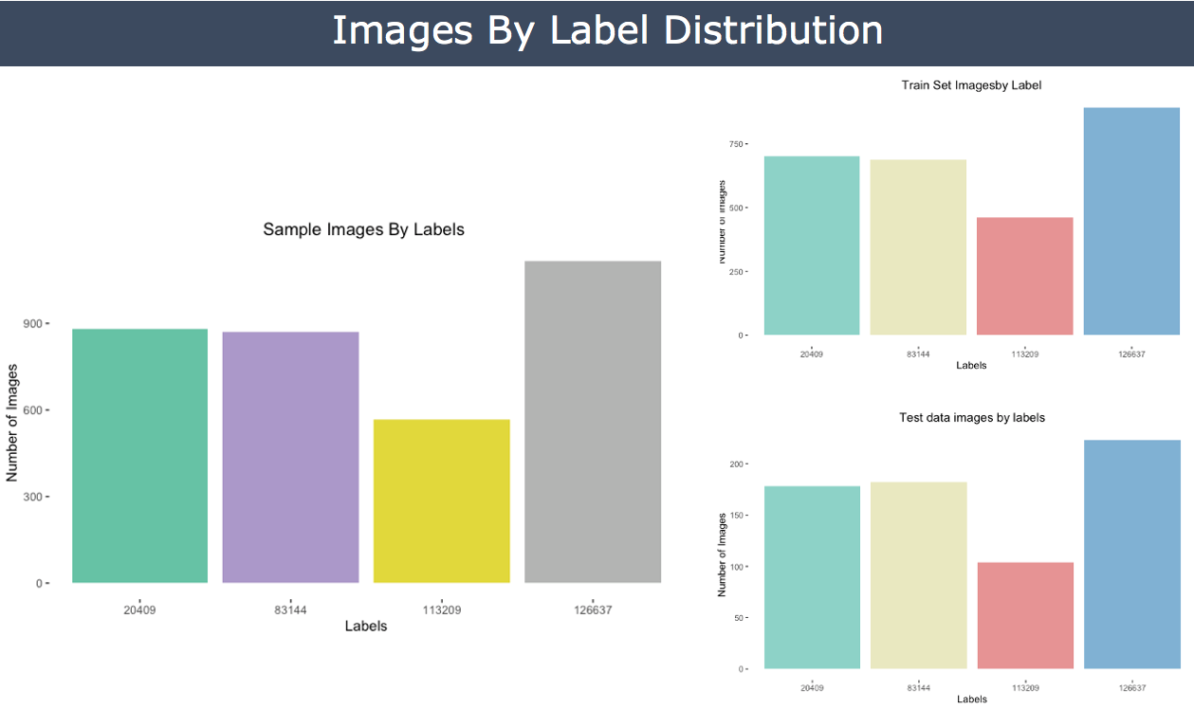

Slide 2
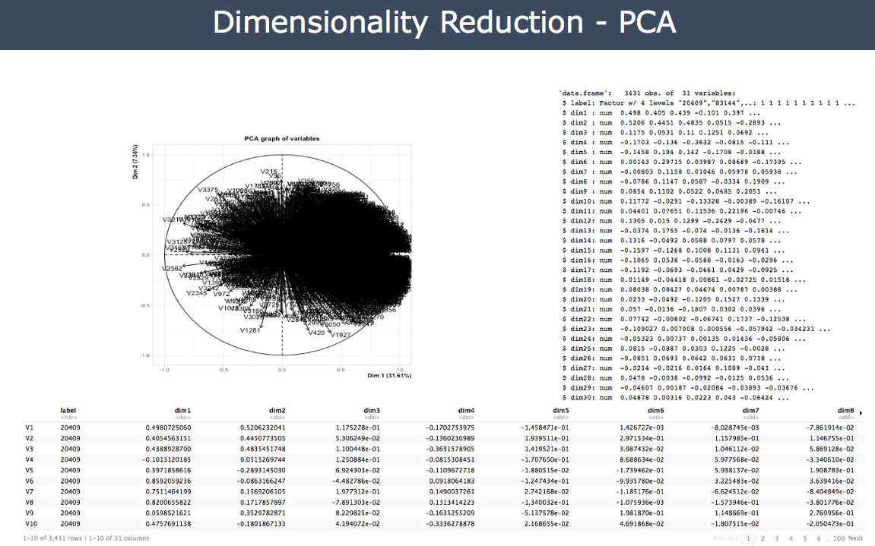

Slide 3
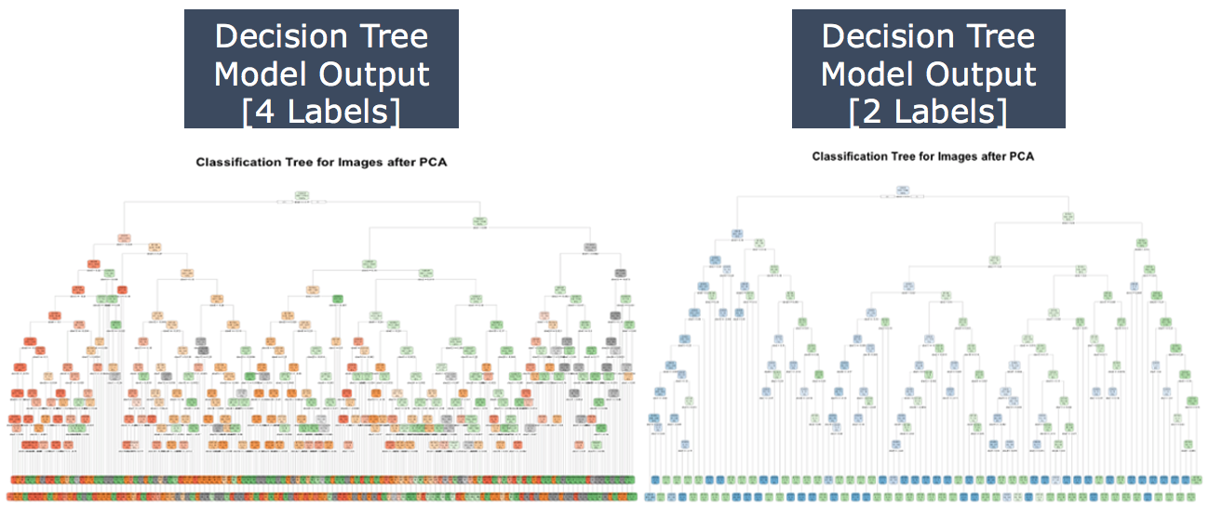

Slide 4
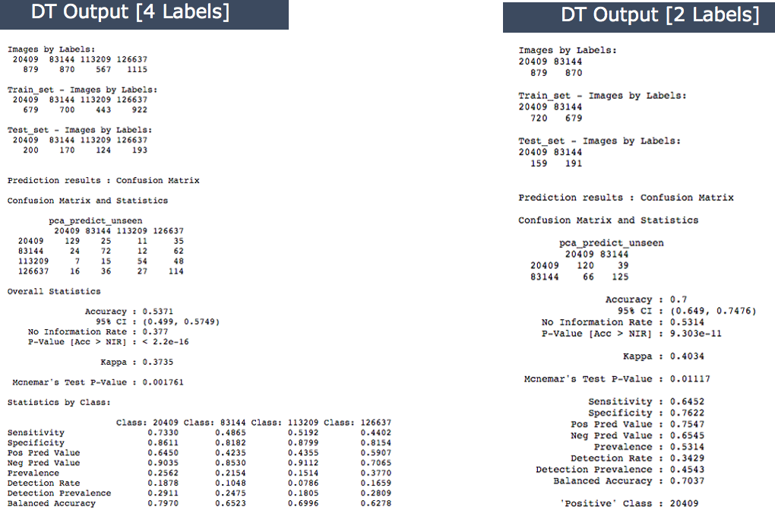

Slide 5
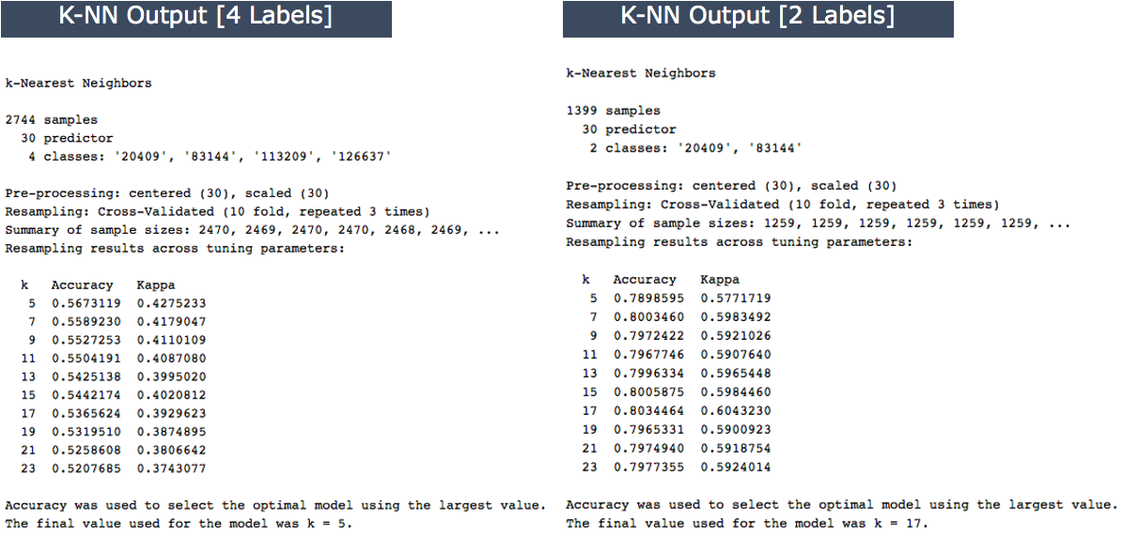

Slide 6
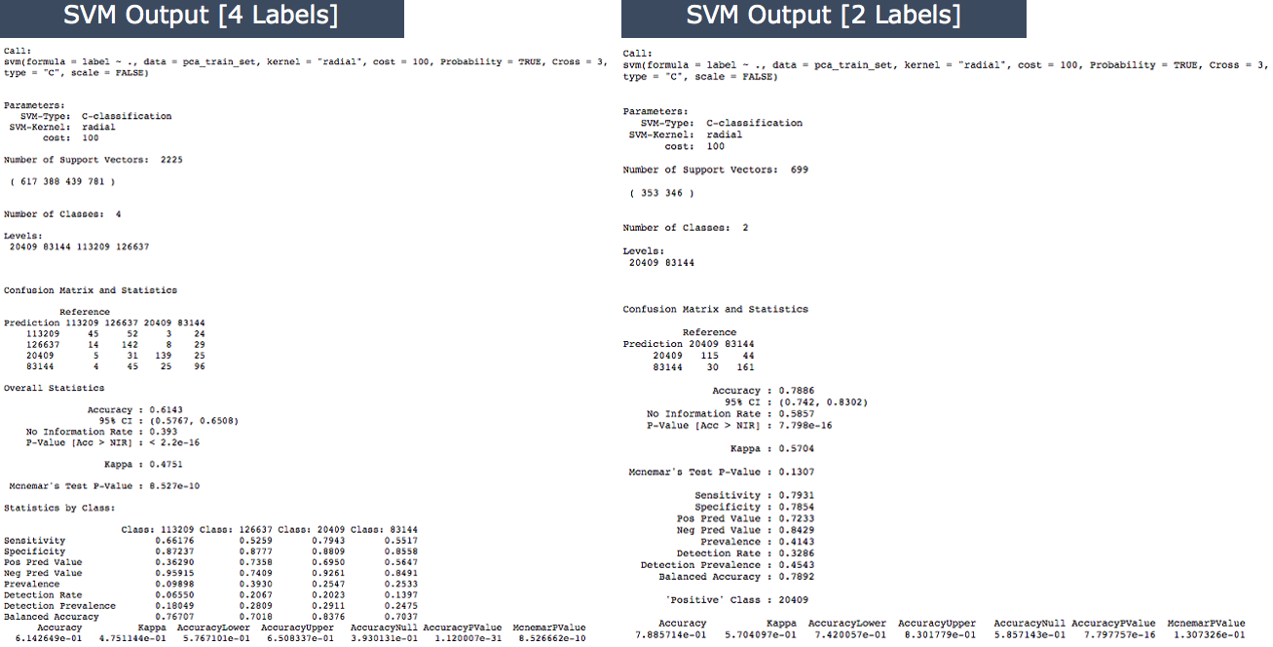

Slide 7
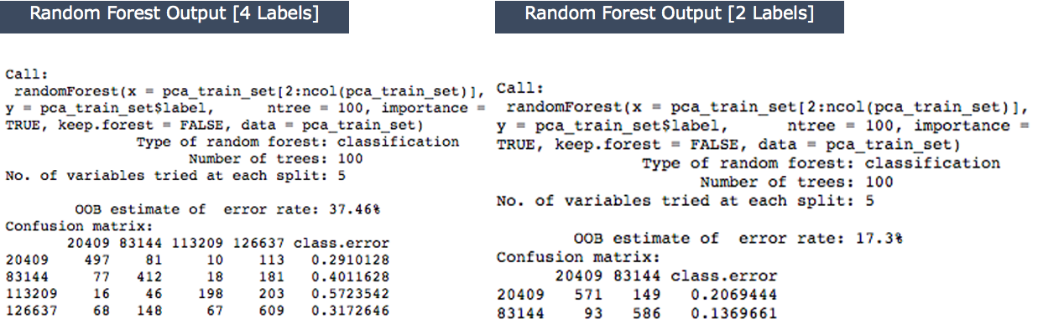

Slide 8
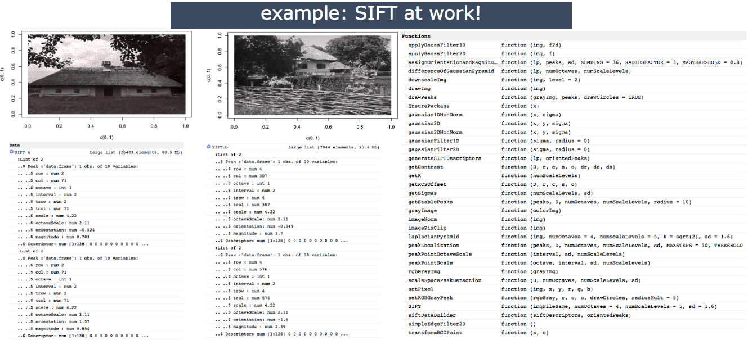

Slide 9
ML Model Name | Accuracy [ 4 Labels] | Accuracy [ 2 Labels]
Decision Tree | 53.71% | 70%
k-Nearest Neighbors (k-NN) | 56.73% [k = 5] | 80.34% [k = 17]
Supply Vector Machine (SVM) | 61.43% | 78.86%
Random Forest | 63.54% | 83.70%

Slide 10
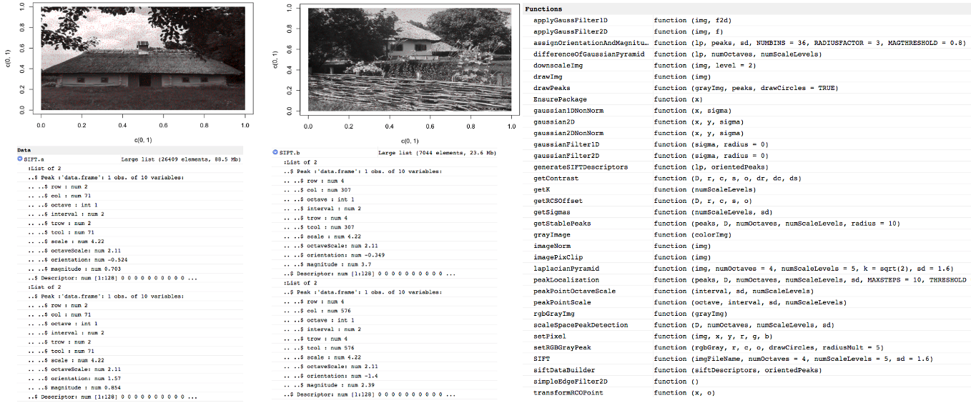
example: SIFT at work!

